Slide 1
CHAPTER FIVE SUGAR INDUSTRY
Objectives
At the end of this chapter you will be able to:
Outline the flow diagram for the manufacturing process of sugar
Grasp basic jobs applied on crushing, milling, purification, carbonisation, sulphitisation, crystallization and centrifugation techniques.

Slide 2
5.1. Manufacture of cane sugar
Sugar is a broad term applied to a large number of carbohydrates present in many plants and characterized by a more or less sweet taste.
The primary sugar, glucose, is a product of photosynthesis and occurs in all green plants.
In most plants, the sugars occur as a mixture that cannot readily be separated into the components.

Slide 3
Cont’d
In the sap of some plants, the sugar mixtures are condensed into syrup.
Juices of sugarcane (Saccharum officinarum) and sugar beet (Beta vulgaris) are rich in pure sucrose, although beet sugar is generally much less sweet than cane sugar.
These two sugar crops are the main sources of commercial sucrose.
Other sugar crops include sweet sorghum, sugar maple, honey, and corn sugar.
The types of sugar used today are white sugar (fully refined sugar), composed of clear, colorless or crystal fragments; or brown sugar, which is less fully refined and contains a greater amount of treacle residue, from which it obtains its color.

Slide 4
Cont’d
The Manufacturing Process
(a) Planting and harvesting
Sugarcane takes about seven months to mature in a tropical area and about 12-22 months in a subtropical area.
At this time, fields of sugarcane are tested for sucrose, and the most mature fields are harvested first.
Harvesting of both cane and sugar beet is done primarily by machine, although in some states it is also done by hand.
The harvested cane stalks and beets are loaded mechanically into trucks or railroad cars and taken to mills for processing into raw sugar.
Once there, they are cleaned, washed, milled to extract juice, filtered, and purified.
The result is a clear, sugar-filled juice.

Slide 5
cont’d
(b) Preparation and processing
After the cane arrives at the mill yards, it is mechanically unloaded, and excessive soil and rocks are removed.
The cane is cleaned by flooding the carrier with warm water (in the case of sparse rock and trash clutter) or by spreading the cane on agitating conveyors that pass through strong jet of water and combing drums (to remove larger amounts of rocks, trash, and leaves, etc.).
At this point, the cane is clean and ready to be milled.

Slide 6
Cont’d
c) Juice extraction pressing
Two or three heavily grooved crusher rollers break the cane and extract a large part of the juice, or swing-hammer type shredders shred the cane without extracting the juice.
Revolving knives cutting the stalks into chips are additional to the crushers.
A combination of two, or even all three, methods may be used.
So the pressing process involves crushing the stalks between the heavy and grooved metal rollers to separate the fiber (bagasse) from the juice that contains the sugar.
Next, the sugar is separated from the cut stalks by dissolving it in hot water or hot juice.
The extracted juice, called vesou, contains 95 percent or more of the sucrose present.

Slide 7
Cont’d
d) Purification of juice — clarification and evaporation
The clarification (or defecation) process is designed to remove both soluble and insoluble impurities (such as sand, soil, and ground rock) that have not been removed by preliminary screening.
The juice from the mills, a dark green color, is acid and turbid.
So the process employs lime and heat as the clarifying agents.
Milk of lime (about one pound per ton of cane) neutralizes the natural acidity of the juice, forming insoluble lime salts.
Heating the lime juice to boiling coagulates the albumin and some of the fats, waxes, and gums, and the precipitate formed entraps suspended solids as well as the minute particles.

Slide 8
Cont’d
The muds separate from the clear juice through sedimentation.
The non-sugar impurities are removed by continuous filtration.
The final clarified juice contains about 85 percent water and has the same composition as the raw extracted juice except for the removed impurities.
Juice from the clarifier or first stage evaporator is first pretreated with an oxidizing agent, such as hydrogen peroxide (H2O2).
The pretreated juice is then passed through columns containing granular activated carbon (GAC) for decolorization.
The first column acts as a guard column, where fines and suspended solids are removed.
The juice is then cooled to 10°C before passing through a bed of strong acid cationic (SAC) resin, which causes a significant drop in pH.

Slide 9
Cont’d
At low pH, sucrose breaks down to glucose and fructose by the process of inversion.
Cooling the juice prevents this from occurring.
To concentrate this clarified juice, about two-thirds of the water is removed through vacuum evaporation.
Generally, four vacuum-boiling cells or bodies are arranged in series so that each succeeding body has a higher vacuum (and therefore boils at a lower temperature).
The vapors from one body can thus boil the juice in the next one—the steam introduced into the first cell does what is called multiple-effect evaporation.
The vapor from the last cell goes to a condenser.
The syrup leaves the last body continuously with about 65 percent solids and 35 percent water.

Slide 10
Cont’d
e) Crystallization
Crystallization takes place in a single-stage vacuum pan.
The syrup is evaporated until saturated with sugar.
As soon as the saturation point has been exceeded, small grains of sugar are added to the pan, or "strike."
These small grains, called seed, serve as nuclei for the formation of sugar crystals.
The growth of the crystals continues until the pan is full.
When sucrose concentration reaches the desired level, the dense mixture of syrup and sugar crystals, called massecuite, is discharged into large containers known as crystallizers.

Slide 11
Cont’d
Crystallization continues in the crystallizers as the massecuite is slowly stirred and cooled.
Massecuite from the mixers is allowed to flow into centrifugals, where the thick syrup, or molasses, is separated from the raw sugar by centrifugal force.
f) Centrifugaling
The high-speed centrifugal action used to separate the massecuite into raw sugar crystals and molasses is done in revolving machines called centrifugals.
The raw sugar is retained in the centrifuge basket because the perforated lining retains the sugar crystals.
The mother liquor, or molasses, passes through the inside layer (due to the centrifugal force exerted).

Slide 12
Cont’d
The final molasses (blackstrap molasses) containing sucrose, reducing sugars, organic non-sugars, ash, and water, is sent to large storage tanks.
Once the sugar is centrifuged, it is "cut down" and sent to a granulator for drying.
g) Drying and packaging
Moist sugar crystals are dried by being fall over through heated air in a granulator.
The dry sugar crystals are then sorted by size through vibrating screens and placed into storage bins.
Sugar is then sent to be packed in the familiar packaging stores or in liquid form for industrial use.

Slide 13
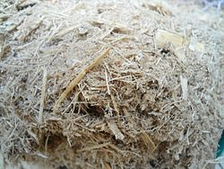
By products of sugarcane
Bagasse
Bagasse is the fibrous matter that remains after sugarcane stalks are crushed to extract their juice.
This is the largest amount of waste that the sugar industry produces and needs special attention for its management.
Bagasse

Slide 14
Historically, bagasse waste has been burnt in the fields causing a large amount of pollution.
Bagasse is composed of fibre, pith, non-soluble solids and water; fibre represents about half of all components, and includes cellulose, hemicellulose and lignin of low molecular weight.
Its morphological structure is not strong in comparison with other fibres like those of wood due to this the most widespread use of bagasse around the world is in the production of pulp and paper.

Slide 15
Use of bagasse
As fuel to generate steam in factories.
For manufacturing biodegradable and compostable food service products,
Green building bricks (made with clays)
Sustainable sound absorber, effective bio-sorbent and wastewater management. For example, common pollutants found in synthetic wastewater, such as, chromium, cadmium, copper-nickel and dyes are effectively absorbed by bagasse.
As an animal feed, but its use is limited by low digestibility even for ruminants.
Steam treatment of the bagasse improves its digestibility so that it can be used in the fattening of cattle

Slide 16
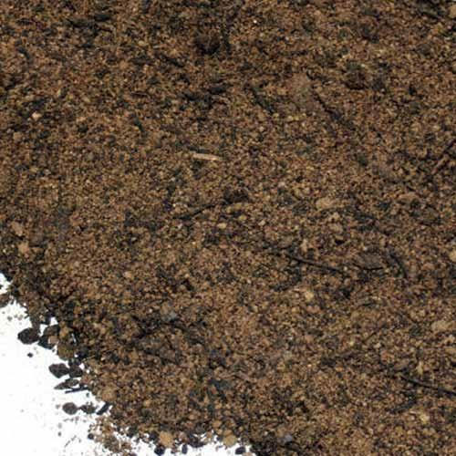
2. Press Mud
Press mud or filter mud is a solid residue obtained from sugarcane juice, before crystallisation of sugar.
It is very important source of fertiliser as well as some chemicals such as protein, sugar and wax.
It is a suitable fertilizing agent, since it is rich in micro, macro nutrient along with organic carbon.
It is used as animal feed for being rich in sugar and minerals.
Press mud

Slide 17
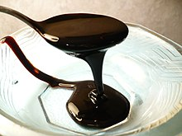
3.Molasses
Molasses is sugar by product and used as raw material to produce alcohol.
Molasses contains about 50 percent sugar and is being used as a sub-stratum of procedures to produce alcohol, nourishment yeast or cattle feed, citric acid glutomic (lysine) as well as for admixture in cattle feed.
Molasses

Slide 18
Review questions
1. What is the purpose of adding crystals of sugar in crystallization process?

Slide 19
Manufacture of sucrose from Beet Root
A sugar beet is a plant whose root contains a high concentration of sucrose and which is grown commercially for sugar production. In plant breeding, it is known as the Altissima cultivar group of the common beet (Beta vulgaris).
Beets are planted from a small seed; 1 kg of beet seed comprises 100,000 seeds and will plant over a hectare of ground .
During its first growing season, it produces a large (1–2 kg) storage root whose dry mass is 15–20% sucrose by weight.
If the plant is not harvested at this time, then during its second growing season, nutrients in the root will be used to produce flowers and seeds and the root will decrease in size.
In commercial beet production, the root is harvested after the first growing season.

Slide 20
Processing
Reception
After they are harvested, beets are transported to a factory.
Each load is weighed and sampled before it gets incline onto the treatment area.
The beet sample is checked for
Soil tare - the amount of non beet delivered
Crown tare - the amount of low sugar beet delivered
Sugar content ("pol") - amount of sucrose in the crop
Nitrogen content - for recommending future fertilizer use to the farmer. From these elements, the actual sugar content of the load is calculated and the grower's payment determined.
The beet is moved from the loads into a central channel or gulley, where it is washed towards the processing plant.

Slide 21
Diffusion
After reception at the processing plant, the beet roots are washed, mechanically sliced into thin strips called cossettes, and passed to a machine called a diffuser to extract the sugar content into a water solution.
Typically cossettes take about 90 minutes to pass through the diffuser, the water only 45 minutes.
The liquid exiting the diffuser is called raw juice.
The colour of raw juice varies from black to a dark red.
The used cossettes, or pulp, exit the diffuser at about 95% moisture but low sucrose content.

Slide 22
Using screw presses, the wet pulp is then pressed down to 75% moisture.
This recovers additional sucrose in the liquid pressed out of the pulp, and reduces the energy needed to dry the pulp.
The pressed pulp (Vinasse), is dried and sold as animal feed or it is used as fertilizer or growth substrate for yeast cultures,
while the liquid pressed out of the pulp is combined with the raw juice.

Slide 23
Carbonatation
Carbonatation is a procedure which removes impurities from raw juice before it undergoes crystallization.
First, the juice is mixed with hot milk of lime (a suspension of calcium hydroxide in water).
This treatment precipitates a number of impurities, including multivalent anions such as sulfate, phosphate, citrate and oxalate, which precipitate as their calcium salts and large organic molecules such as proteins, saponins and pectins, which aggregate in the presence of multivalent cations.

Slide 24
Next, carbon dioxide is bubbled through the alkaline sugar solution, precipitating the lime as calcium carbonate (chalk).
The chalk particles entrap some impurities and absorb others.
A recycling process builds up the size of chalk particles and a natural flocculation occurs where the heavy particles settle out in tanks (clarifiers).
A final addition of more carbon dioxide precipitates more calcium from solution; this is filtered off, leaving a cleaner, golden light-brown sugar solution called thin juice.
Before entering the next stage, the thin juice may receive soda ash to modify the pH and sulphitation with a sulfur-based compound to reduce colour formation due to decomposition of monosaccharides under heat.

Slide 25
Evaporation
The thin juice is concentrated via multiple-effect evaporation to make a thick juice, roughly 60% sucrose by weight and similar in appearance to pancake syrup. Thick juice can be stored in tanks for later processing.
Crystallization
Thick juice is fed to the crystallizers. Recycled sugar is dissolved into it, and the resulting syrup is called mother liquor.
The liquor is concentrated further by boiling under a vacuum in large vessels (the so-called vacuum pans) and seeded with fine sugar crystals.
These crystals grow as sugar from the mother liquor forms around them. The resulting sugar crystal and syrup mix is called a massecuite, from "cooked mass" in French.

Slide 26
The massecuite is passed to a centrifuge where the liquid is removed from the sugar crystals.
The syrup separated is molasses, which still contains sugar but contains too much impurity to undergo further processing economically.
f) Drying and packaging
The remaining syrup is rinsed off with water and the crystals are dried in a granulator using warm air.
At the end the dry sugar crystals are sorted by size through vibrating screens and placed into storage bins.
Sugar is then sent to be packed in the familiar packaging stores or in liquid form for industrial use.

Slide 27
Sugar quality process
Sugar is tested in many ways to validate its quality.
These tests are according to a standard set of quality parameters that are important in demonstrating to potential buyers if the sugar meets the required standard.
Sugar quality is important because it impacts the extractable sugar – the amount of sugar that can be extracted from the milling or refining processes.
The following quality control measures consider the purity, colour and texture of the sugar.
Polarisation
Polarisation (pol) measures the purity of the sugar, with the sucrose content of the sugar provided as a mass percentage. It is the main standard that is used to determine the quality of the sugar.

Slide 28
A sugar crystal is very close to 100% pure sucrose, which is why pol is a useful measure.
The higher the polarisation, the purer the sugar is; the lesser the polarisation, the more impurities are present in the sugar.
Polarisation is measured by the optical rotation of polarised light, passing through the sugar.
This means measuring the amount of light refracted through the final product.
Molasses and other impurities make the sugar darker in colour, and therefore more difficult for light to pass through.

Slide 29
Ash
Ash refers to all the inorganic components that are naturally present in the cane or beet.
It is present in cane juice, and is carried over in a smaller amount into raw sugar.
Ash is made up of both soluble and insoluble compounds and can be determined by the conductivity of the solution.
It is quite complex chemistry, but essentially a conductance meter is used to measure the soluble, inorganic compounds present in the sugar.
If there is a high ash content in raw sugar, higher refining costs will be earned as it will take longer to purify and there will be less yield.

Slide 30
Moisture
Reducing moisture in sugar is very important, as sugar is hygroscopic (meaning it absorbs moisture from the air) and can ‘cake’ if it becomes too moist.
Generally speaking, moisture in sugar can be separated into three separate categories and is expressed as a percentage:
Bound moisture – the moisture trapped between the crystallised sugar and a thin surface layer of amorphous sugar
Internal moisture – the moisture inside the crystal itself
Free moisture – the surface moisture in the syrup film
The optimal moisture content of refined sugar is typically between 0.02 and 0.05%, and of raw sugar between 0.25 and 1.10%.

Slide 31
Crystal size and uniformity
Crystal size, also known as ‘screen size’.
It is important to refineries to know that the sugar has met a certain screen size, and important to mills that they are able to produce uniform sugar that is able to fetch a profit.
Colour measurement
Another way that sugar quality is measured is through ‘colour’. The term colour refers to a wide range of complex and molecular components that contribute to the overall appearance of sugar.

Slide 32
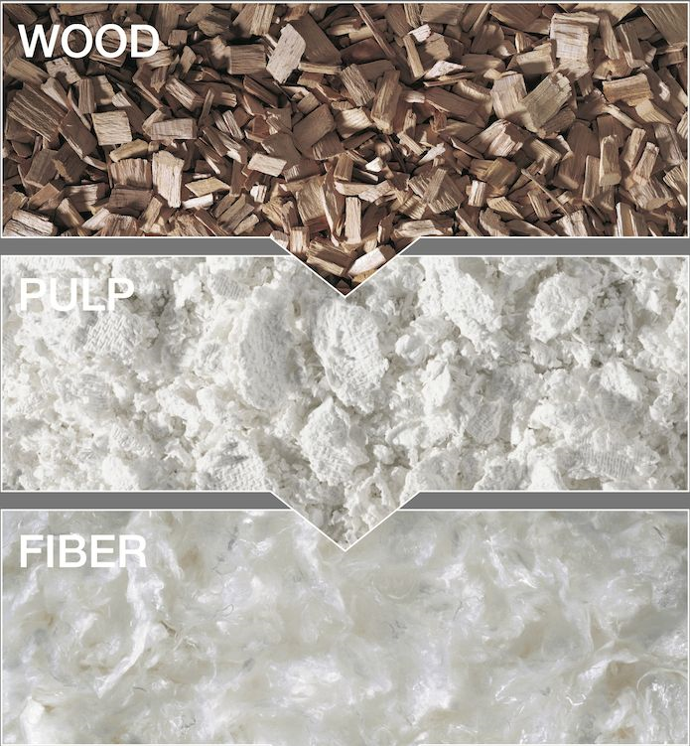
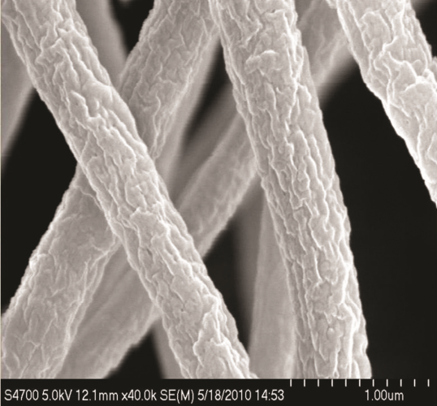
CHAPTER SEVEN THE PAPER AND PULP INDUSTRY
Paper and boards are produced from a pulp which is a mixture of cellulose fibres and water (up to 99%).
The cellulose fibres are usually derived from finely shredded wood. But other materials can be used to such as bamboo or hemp to produce paper.
Wood generally provides the best results and this is why it is used. Woods which are deciduous and coniferous are used.
WOOD
PULP
Cellulose under a microscope
FIBRE

Slide 33
Paper Pulping
Pulping of wood can be done in two ways: mechanically or chemically.
Mechanical pulp
In the case of mechanical pulp, the wood is processed into fibre form by grinding it against a quickly rotating stone under addition of water.
The result is called wood pulp or MP – mechanical pulp.
The disadvantage of this type of pulp is that the fibre is strongly damaged and that there are all sorts of impurities in the pulp mass.
Chemical pulp
For the production of wood pulp, the pure fibre has to be set free, which means that the lignin has to be removed as well.
To achieve this, the wood chips are cooked in a chemical
solution.

Slide 34
Chemical pulps are made by cooking (digesting) the raw materials, using the kraft (sulfate) and sulfite processes.
In the kraft pulp process the active cooking chemicals (white liquor) are sodium hydroxide (NaOH) and sodium sulfide (Na₂S).
Kraft pulp possesses superior pulp strength properties in comparison to sulphite pulp.
Kraft processes produce a variety of pulps used mainly for packaging and high-strength papers and board.
In the sulfite process Acid sulphite, Bisulphite, Neutral sulphite (NSSC), and Alkaline sulphite are mainly used to attack and remove lignin.

Slide 35
Pulp washing and screening
To removes impurities and recycles any residual cooking liquor via the pulp washing process.
Bleaching
Bleaching is any process that chemically alters pulp to increase its brightness.
The principal pulp bleaching agents are chlorine, chlorine dioxide, hypochlorite, peroxide, chlorite, oxygen and ozone.
Stock Preparation
Stock preparation is conducted to convert raw stock into finished stock (furnish) for the paper machine.
The pulp is prepared for the paper machine including the blending of different pulps, dilution, and the addition of chemicals.

Slide 36
The Wet-end Operation
The pulp is pumped into the headbox of the paper machine at this point. The slurry consists of approximately 99.5% water and approximately 0.5% pulp fiber. The exit point for the slurry is the “slice” or head box opening.
As the wire moves along the machine path, water drains through the mesh.
Pressing and Drying
As the paper enters the press section, it undergoes compression between two rotating rolls to squeeze out more water.
Then it continues its way through the steam heated dryers losing moisture each step of the way.
About 90% of the cost of removing water from the sheet occurs during the pressing and drying operations.

Slide 37
Coating/Calendering
Coating is the treatment of the paper surface with clay or other pigments and/or adhesives to enhance printing quality, color, smoothness, opacity, or other surface characteristics. There is a great demand for paper with a very smooth printing surface.
Finishing
At the end of the drying process, the sheet is smoothed using an "ironing" method, which consists of hot polished iron rollers mounted in pairs with synthetic material rollers, one above the other.
Shipping
The paper comes off the machine ready for reeling up into large reels, which can be cut or slit into smaller ones, according to customer requirements.

Slide 38
Generally
Pulping procedure will be done to separate and clean the fibres
2) Refining procedure will be followed after pulping processes
3) Dilution process to form a thin fibre mixture
4) Formation of fibres on a thin screened
5) Pressurisation to enhance the materials density
6) Drying to eliminate the density of materials
7) Finishing procedure to provide a suitable surface for usage

Slide 39
Quality control
To ensure that the paper or board is of a consistently high quality. Moreover, for food contact applications, microbiological and chemical controls have to be carried out.

Slide 40
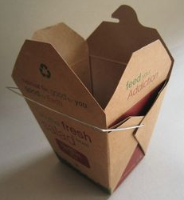
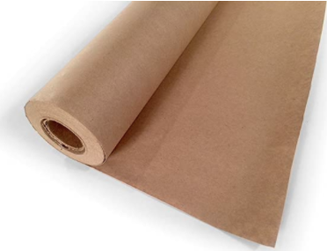
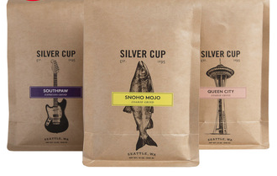
Types of Paper
Paper is divided into two broad categories: fine papers, generally made of bleached pulp, and typically used for writing paper, bond, ledger, book and cover papers, and coarse papers, generally made of unbleached kraft softwood pulps and used for packaging.
Kraft Paper
This is typically a coarse paper with exceptional strength, often made on a machine and then either machine-glazed on a dryer or machine-finished on a calender. It is sometimes made with no calendering so that when it is converted into bags, the rough surface will prevent them from sliding over one another when stacked on pallets.

Slide 41
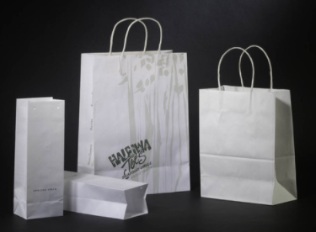
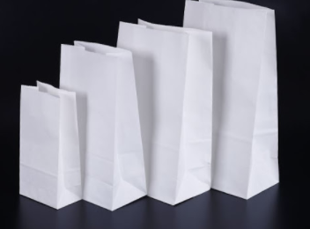
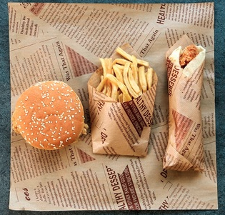
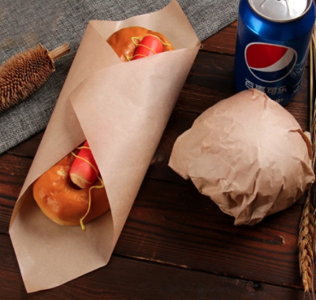
Bleached Paper
These are manufactured from pulps which are relatively white, bright and soft and receptive to the special chemicals necessary to develop many functional properties. They are generally more expensive and weaker than unbleached papers.
Greaseproof Paper
This is a translucent, machine-finished paper which has been hydrated to give oil and grease resistance.
8

Slide 42

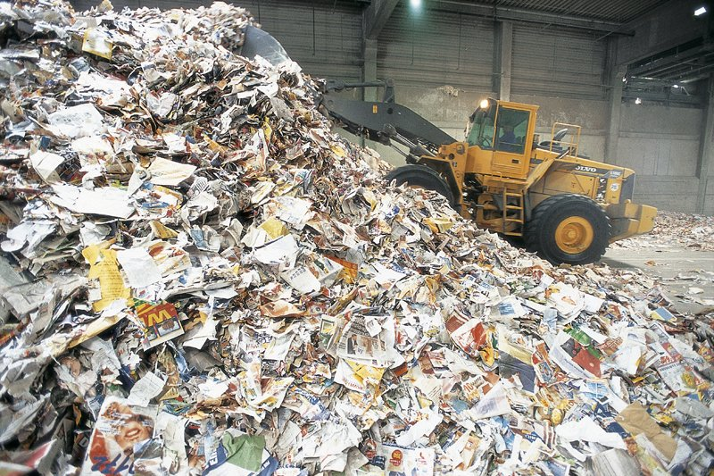
Paper & the environment.
Like many materials paper if it is not disposed off sensibly will end up in landfill.
MATHS TASK – HOW MANY TREES ARE USED yearly THEN?
Trees are important to the environment because they absorb carbon dioxide and provide habitats for animals.
Paper in landfill decomposes giving of methane which is a greenhouse gas.

Slide 43
Recycling paper and boards is easily and widely accessible to do so. When paper is disposed off in a specialised paper bin it is sent to be graded.
Magazines which are produced out of high quality glossy paper will produce a higher quality of recycled paper than a newspaper would do.
The energy it needs to produce brand new paper from pulp and those from recycled materials is between 40-70% more.
THEREFORE RECYCLE YOUR PAPER/MAGAZINES!

Slide 44
Chapter- 8 Chemical foodstuff processing
Objective
To identify the alcoholic content of beer, wines and distilled beverages
To discuss the industrial manufacture of Beer, Wine, and Spirits

Slide 45
8.1. Alcoholic Beverages
An alcoholic beverage is a drink containing ethanol, commonly known as alcohol.
Alcohol is a psychoactive drug that has a depressant effect.
A high blood alcohol content is usually considered to be legal drunkenness because it reduces attention and slows reaction speed.
Alcohol can be addictive, and the state of addiction to alcohol is known as alcoholism.
Alcoholic beverages that have a lower alcohol content (beer and wine) are produced by fermentation of sugar- or starch-containing plant material.
Beverages of higher alcohol content (spirits) are produced by fermentation followed by distillation.
Alcoholic beverages are divided into three general classes: beers, wines, and spirits.

Slide 46
Beer
Beer is the world's oldest and most widely consumed alcoholic beverage and the third most popular drink overall after water and tea.
It is produced by the brewing and fermentation of starches which are mainly derived from cereal grains — most commonly malted barley although wheat, maize (corn), and rice are also used.
Alcoholic beverages that are distilled after fermentation, are fermented from noncereal sources such as grapes or honey, or are fermented from unmalted cereal grain are not classified as beer.
The two main types of beer are lager and ale.
Ale is further classified into varieties such as pale ale, stout, and brown ale.

Slide 47
Most beer is flavored with hops, which add bitterness and act as a natural preservative.
Other flavorings, such as fruits or herbs, may also be used.
The alcoholic strength of beer is usually 4% to 6% alcohol by volume (ABV), but it may be less than 2% or as much as 12%.
Manufacture of Beer
Raw materials
Barley
Barley may be regarded as the backbone of beer.
Barley provides fermentable sugars that yeast convert to alcohol during fermentation, dextrins that give beer mouth-feel and body, colour, proteins responsible for beer foam and malty flavours and aromas that balance hop bitterness in the final beer.

Slide 48
Cont’d
The barley used must be viable, free of disease, infection and discolouration, and reasonably free of debris and damaged corns.
The grain should be relatively low in nitrogen (i.e. 9-12% protein), have vigorous germination, the potential for rapid and complete modification and the ability to yield high levels of brewing enzymes.
Steps carried out:
Malting
a) Steeping
During steeping the barley grains are soaked (“imbibed with”) in water. The first flush of water removes surface dirt and other impurities.
After this the grains are soaked until they absorb about 45% water.

Slide 49
The water is changed every 6 to 8 hours over a period of usually between 24 (Australia) and 48 hours (Europe/USA), so steeping uses a lot of water.
Air is also needed during steeping because the grains are living and breathing organisms which require oxygen for energy and excrete carbon dioxide when making that energy.

Slide 50
Chemistry in steeping
During steeping the barley starts to produce enzymes (the production of enzymes is completed during germination).
The enzymes degrade starches into simple sugars (ie maltose) that can be utilised by the growing grain.
The energy to produce these comes from the respiration of the simple sugars, with a simplified equation:
C6H12O6 (in starch) + 6O2 6CO2 + 6H2O + heat
In order to control the malting process it is important to maintain a supply of oxygen, remove the carbon dioxide and make sure the temperature doesn’t rise too high.
As well as this, if the steeping process goes for too long some of the starches will be oxidised away.

Slide 51
b) Germination
The barley grains are allowed to germinate, producing new barley plants. This produces enzymes which are needed to convert starch into sugars and to break down some of the hard, insoluble parts of the barley.
During germination the barley grains grow rootlets called ‘chits’.
The germination process also needs a constant supply of water and air.
During germination the cell walls of the grains are broken down, and germination is complete when they can be crushed with the fingers.
Mass loss during germination
There is a mass loss due to respiration and the formation of the rootlets (which are discarded).

Slide 52
Cont’d
Limit-dextrinase complete the breakdown of larger sugar molecules that are branched (limit dextrins) simple sugars that may be further hydrolysed into fermentable sugars such as maltose and glucose.
b-glucanase (produced during germination) break down b-glucan, a complex sugar polymer which is used to hold the cell walls together, into smaller polysaccarides which in turn can be further broken down into glucose.
Proteanases break down the proteins in the cell wall into smaller peptides and soluble amino acids.

Slide 53
The enzymes in malting
The enzymes are proteins which are produced by the action of plant hormones called gibberellins.
The enzymes are produced or released during germination. Some of the enzymes start their work during germination, breaking down the cell walls and converting some of the insoluble, high molecular weight cell wall polysaccharides small sized polymers and eventually into sugars.
Some of the enzymes produced or released during malting, and the work that they do are:
a-amylase (which are produced during germination) break down long starch chains into smaller ‘dextrins’. This enzyme is the first to attack the starch granule.
b-amylase (which are released and modified during germination) break down smaller molecules (dextrins) into maltose.

Slide 54
c)Kilning
Hot air dries and kills the green malt which is then heated at temperatures normally beginning at about 50°C and reaching a final temperature normally between 80 about 100°C in 24 hours.
The kilning releases a wide variety of different flavours and colours by a series browning reactions between sugars and peptides/amino acids called Maillard Reactions.
After kilning the ‘green malt’ has become ‘malt’.

Slide 55
Flavour and colour control during malting
There are lots of things the beer maker can do during malting to change the final flavour and colour of the beer. Here are a few examples.
In the final stages of kilning, the malt can be ‘cured’ at a high temperature.
Malts can be wetted and roasted at very high temperatures (up to 200°C) to produce crystal (caramel), chocolate (black) and amber malts.
These are used in small proportions to give colour and flavour to the beers.
Dark beers like stout will use about 5-10% proportion of dark malts.

Slide 56
Cont’d
Some of the types of malts are:
Roasted Barley provides black colour and bitter taste
Roasted Wheat provides colour and unique flavour
Light Crystal Malt used for colour, flavour, head retention, storage
Dark Crystal Malt used for colour
Roasted Chocolate provides a malt flavour (smoother) and colour
Black Malt provides almost black colour and bitter and dry taste
Amber Malt provides a subtle biscuity colour and flavour
Caramalt Golden provides colour and full caramel flavour

Slide 57
Storage
The dried malt (ca 5% moisture) is now in a form that can be readily and stably, stored and transported.
In storage and transport it is important that the malt is kept dry and free from insects and rodents.
Gelatinisation
The enzymes which attack proteins and glucans ideally do most of their work during malting. However, the starch is contained in granules which must be burst open by heating before the enzymes can get to work on them.
This process is called ‘gelatinisation’ and takes place during mashing.

Slide 58
Barley malt gelatinises at 60°C while some of the adjuncts will gelatinise at higher temperatures.
The brewer must control the temperature
The precise temperature can have a very significant effect on how the amylases work, producing different proportions of fermentable sugars.
The optimum pH for amylase activity is between 5.2 and 5.6. Since malts usually have higher pH values, the mash must be made more acidic, a process that was traditionally called ‘souring the malt’.
This is done in Tasmania by adding Calcium Sulfate.

Slide 59
2) Brewing
A) Milling
The malt is now crushed in a ‘grist mill’. This breaks down barriers in the grains, giving the enzymes full access to the carbohydrates that are still in the grains, and facilitates the efficient extraction of the soluble material (extract) from the malt. The malt now is called ‘malt grist’. B ) Mashing
During mashing the starches in the grist are converted to sugars. The grist is mixed with high quality heated water, usually around 65°C.
The soluble materials produced during mashing are called the extract and the solution of soluble materials in water is called the wort.

Slide 60
Water quality in mashing
The activity of enzymes has a dependency on temperature and pH.
There is an optimum temperature and an optimum pH at which the activity of the yeast is a maximum:
The value of these depends on the particular enzyme. C) Lautering
After the completion of mashing (normally 1 hour) the mash is transfered into the lauter tun which is rather like a large strainer. The husks settle at the base of the lauter tun forming a filter bed which traps all the remaining grist solids and allows the wort containing the solubilized malt components to pass through as a relatively transparent liquor called wort.
Sparging with hot water washes out the sugars from the mash.

Slide 61
cont’d
The final alcohol content of beer depends on the sugar content of the wort. This is determined using a hydrometer which measures the density or ‘specific gravity’ of the wort which is numerically the same as its density in grams per millilitre.
D) Boiling
The wort is now boiled vigorously in a ‘kettle’ for about an hour, and at different stages during the boiling hops are added.
The reasons for boiling are to:
sterilize the wort rendering it bacteriologically stable
precipitate out undesirable proteins, tannins and carbohydrates
inactivate enzymes that survive mashing
modify remaining proteins (i.e. more foam active) and allow further browning/Millard reactions to occur
concentrate the wort through evaporation
bring out the flavours in the hops
boil away some undesirable flavours (such as dimethy sulfide DMS).

Slide 62
Hops
Hops are one of the essential flavouring ingredients of most beers.
The main flavour contributed by hops is a bitter flavour, and to get this bittering effect hops are added to the wort at the beginning of boiling.
Hops also contain essential oils which have a strong aroma, and special aroma hops may be added to the wort near the end of boiling so that the essential oils do not distil off.

Slide 63
3) Fermentation
Yeasts
Yeasts are viable, living cells that are pitched into the wort and utilise the fermentable wort sugars to produce alcohol and carbon dioxide for their respiration/energy requirements.
The wort is food for the yeast cells which multiply during fermentation.
Yeasts are living and growing organisms that need energy.
At the beginning of the fermentation process, dissolved oxygen in the wort allows the yeasts to grow by respiration. This is an important process because it gets the yeast working and saves a lot of time.
C6H12O6 (aq) + 6O2 (aq) 6CO2 (aq) + 6H2O(l) DH = - 2825 kJmol-1
When all the oxygen in the wort is used up, anaerobic conditions prevail in the wort thus the yeast obtains its energy by fermentation that is the process that creates alcohol.
Primary fermentation turns the sugars in the wort into alcohol and carbon dioxide and it produces ‘green beer’ .
C6H12O6 2C2H5OH(aq) + 2CO2 (g) DH = - 106 kJmol-1

Slide 64
Temperature is important in determining the activity of yeast.
At low temperatures the metabolic processes in yeasts are slow, while at high temperatures the living yeasts become inactive and may die. 4) Maturation
The green beer produced in primary fermentation is cloudy, flat, has funny flavours and can easily spoil. It has to go through a few more stages before it is ready to drink. The first step is the maturation of the beer during which
the yeast settles (and is collected for future use)
the flavours mature through fermentation of undesirable primary fermentation products
hazy components are precipitated out
the final product can be standardised through blending and dilution to correct alcohol concentration.

Slide 65
5) The final beer
Colour, foam amount and stability, brightness, carbon dioxide content, mouth-feel and hop aroma, flavour and bitterness are all involved in the complex exercise of evaluating a glass of beer.
What makes a good beer ?

Slide 66
Wine
Wine is produced from grapes, and fruit wine is produced from fruits such as plums, cherries, or apples.
Wine involves a longer fermentation process than beer and also a long aging process (months or years), resulting in an alcohol content of 9%–16% ABV.
Sparkling wine can be made by means of a secondary fermentation.
Fortified wine is wine (such as port or sherry), to which a distilled beverage (usually brandy) has been added.

Slide 67
Spirits
Unsweetened, distilled, alcoholic beverages that have an alcohol content of at least 20% ABV are called spirits.
Spirits are produced by the distillation of a fermented base product.
Distilling concentrates the alcohol and eliminates some of the congeners.
Spirits can be added to wines to create fortified wines, such as port and sherry.

